Slide 1
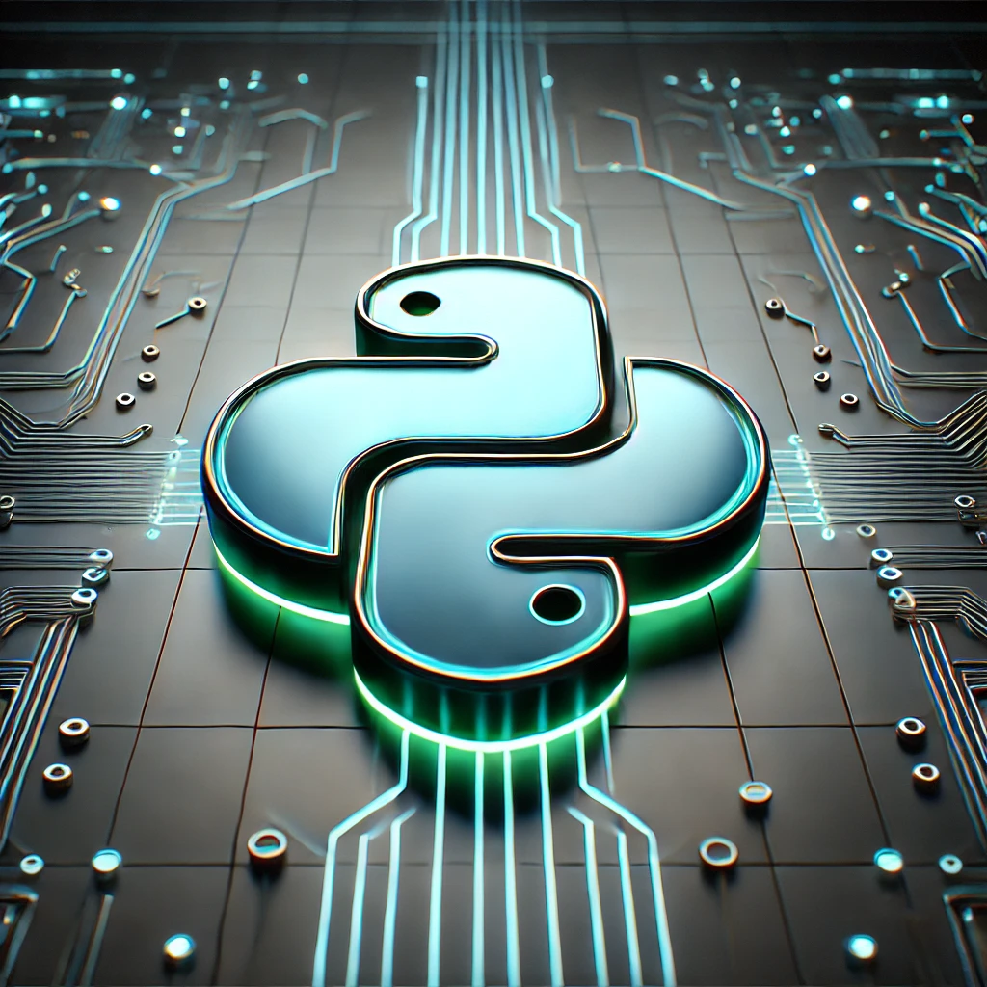
Python 3.12, 3.13 aNd BEYOND
Alex PRENGERE

Slide 2
Python 3.12 – 3.13
3.12 Released on 2023-10-02 (1 year after 3.11)
As any release since 3.8, it will be followed by:
1.5 years of bugfix releases (~ every 2 months)
3.5 years of security releases after (source only)
3.13 Released on 2024-10-07 (1 year after 3.12)
As any release since 3.13, it will be followed by:
2 years of bugfix releases (~ every 2 months)
3 years of security releases after (source only)
(notice the change, PEP 602 was updated)

Slide 3
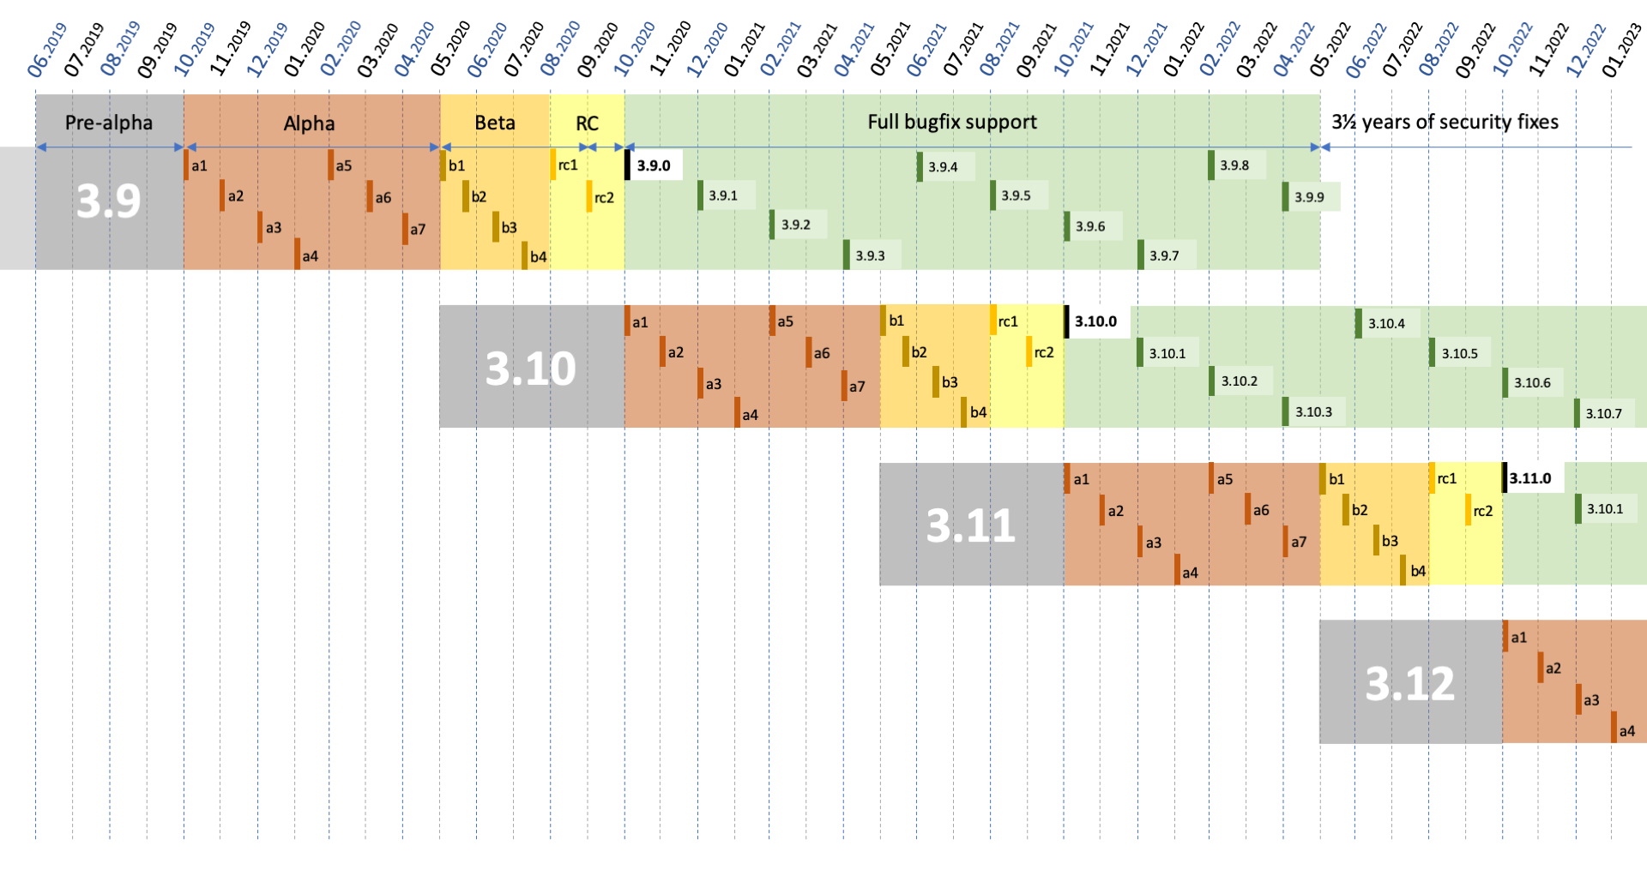

Slide 4
3.0
3.1
3.2
3.3
3.4
3.5
3.6
3.7
3.8
3.9
3.10
3.11
3.12
Alpha releases
Beta release
Stable release
F-strings
ASync
Type Annotations
Walrus
Pat. Mat.
Typing improvements
Exc. Groups
Performance
improvements
3.13
Free-threaded builds
3.14

Slide 5
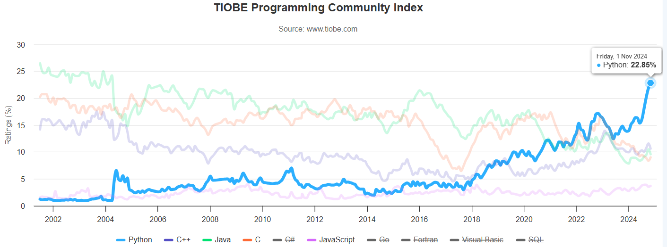

Slide 6
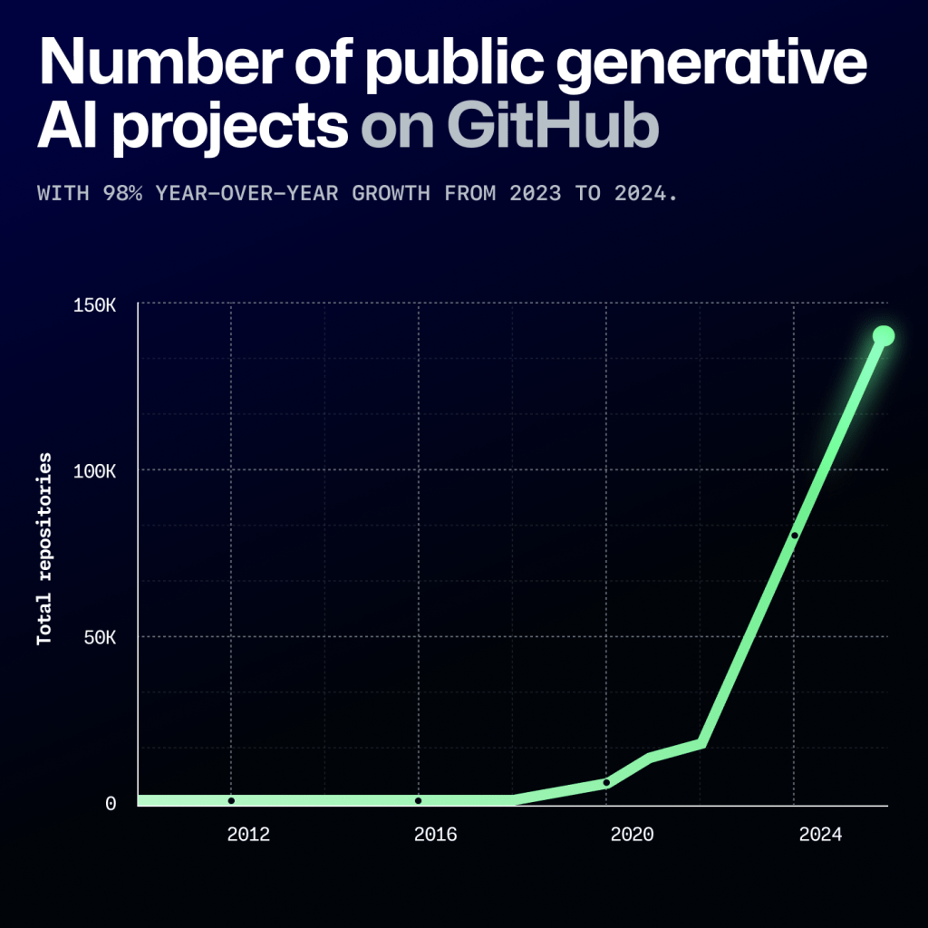
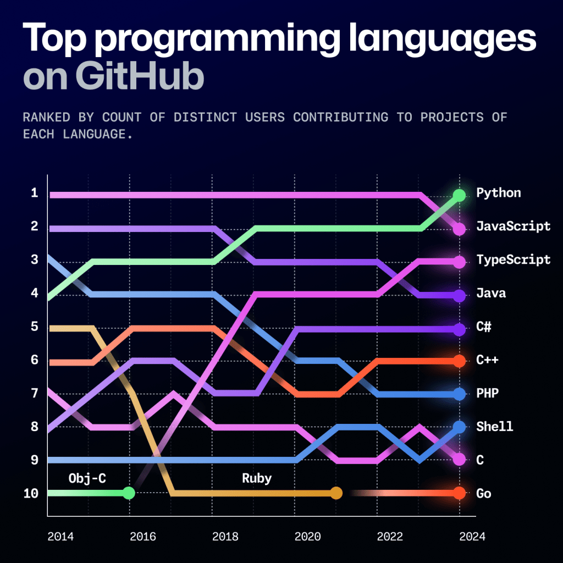
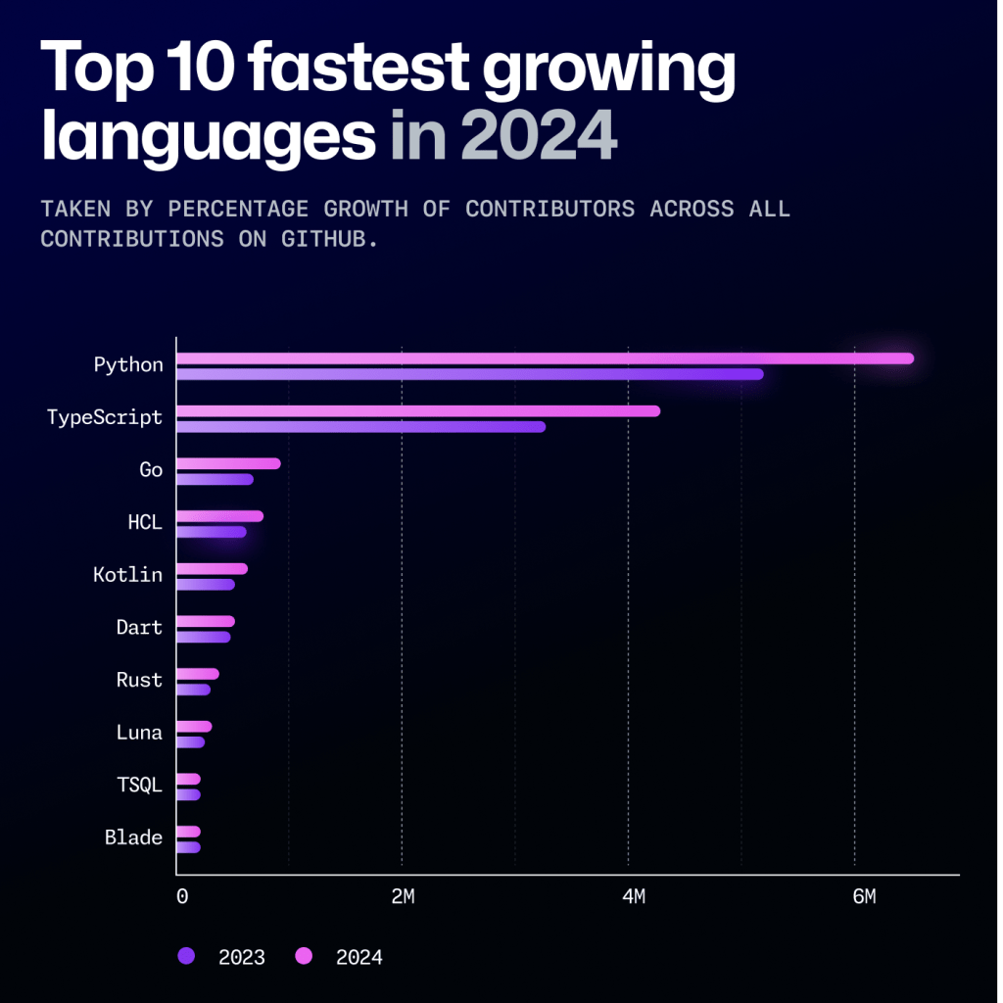
Github octoverse 2024
Notes:
JavaScript still ranks first for code pushes alone.
TypeScript is cutting into JavaScript: While Python is increasing in contributor counts for both code push activity alone and other activity faster than JavaScript, it isn’t increasing in those faster than JavaScript and TypeScript combined.

Slide 7
3.12
Type Parameter Syntax
Formalization of f-strings
Per-Interpreter GIL

Slide 8
PEP 695: Type Parameter Syntax
from typing import TypeVar
_T = TypeVar("_T")
def func(a: _T, b: _T) -> _T:
...
def func[T](a: T, b: T) -> T:
...

Slide 9
PEP 695: Type Parameter Syntax
from typing import TypeAlias
_T = TypeVar("_T")
ListOrSet: TypeAlias = list[_T] | set[_T]
type ListOrSet[T] = list[T] | set[T]

Slide 10
PEP 701: Syntactic formalization of f-strings
# Nested quotes!
>>> f"{f"{f"{f"{f"{f"{1+1}"}"}"}"}"}"
'2'
# F-strings expressions can contain backslashes!
>>> print(f"This is the playlist: {"\n".join(songs)}")
# F-strings expressions can contain newlines and comments!
>>> f"This is the playlist: {", ".join([
... 'Take me back to Eden', # My, my, those eyes like fire
... 'Alkaline', # Not acid nor alkaline
... 'Ascensionism' # Take to the broken skies at last
... ])}"
'This is the playlist: Take me back to Eden, Alkaline, Ascensionism'

Slide 11
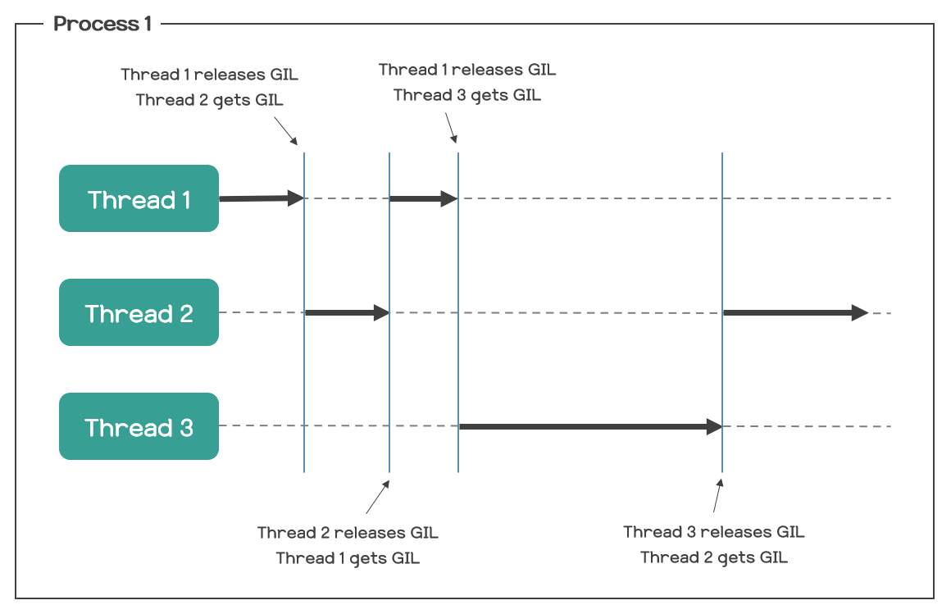
ThE GIL – Global interpreter lock
The Python Global Interpreter Lock or GIL, in simple words, is a mutex (or a lock) that allows only one thread to hold the control of the Python interpreter.

Slide 12
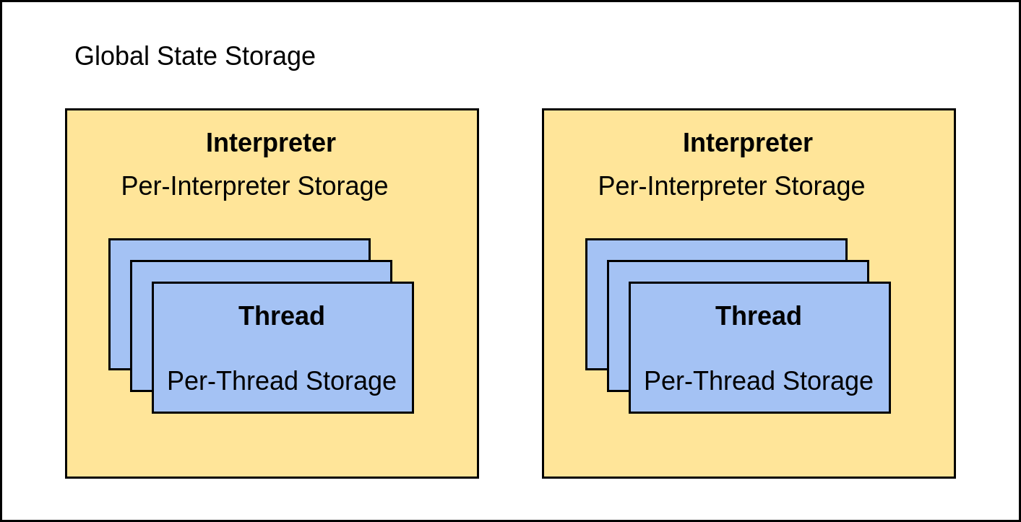
PEP 684: A Per-Interpreter GIL
A subinterpreter is a copy of the full CPython interpreter that can run independently from the main interpreter that started alongside your program.

Slide 13
PEP 684: A Per-Interpreter GIL
PEP 684 introduces a per-interpreter GIL, so that sub-interpreters may now be created with a unique GIL per interpreter. This is currently only available through the C-API, though a Python API is anticipated for 3.13.
PyInterpreterConfig config = {
.check_multi_interp_extensions = 1,
.gil = PyInterpreterConfig_OWN_GIL,
};
PyThreadState *tstate = NULL;
PyStatus status = Py_NewInterpreterFromConfig(&tstate, &config);
if (PyStatus_Exception(status)) {
return -1;
}
/* The new interpreter is now active in the current thread. */
But concurrent.futures.InterpreterPoolExecutor is coming to 3.14 (!)

Slide 14
PEP 684: A Per-Interpreter GIL
Model | Execution | Start-up time | Data Exchange | Style
coroutine | Concurrent | smallest | Any | Cooperative
threads | Parallel * | small | Any | Preemptive
multiprocessing | Parallel | large | Serialization or Shared Memory | Preemptive
subinterpreters | Parallel | medium | Serialization or Shared Memory | Preemptive
(*) On regular Python builds, multi-threading is not really parallel because of the GIL

Slide 15
3.13
New Interactive Interpreter
Free-threaded builds
The JIT

Slide 16
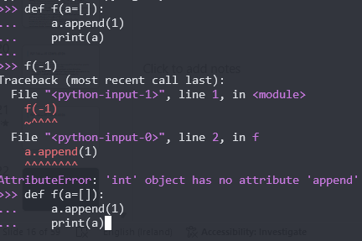
A new INTERACTIVE INTERPRETER
Multiline editing with history preservation.
Prompts and tracebacks with colors.
Interactive help browsing using F1 with a separate command history.
History browsing using F2.
“Paste mode” with F3.

Slide 17
PEP 703 – Making the GIL Optional in CPython
This PEP proposes adding a build configuration (--disable-gil) to CPython to let it run Python code without the global interpreter lock and with the necessary changes needed to make the interpreter thread-safe.
New “deferred” reference counting
Rework garbage collection
Rework data structures for thread-safe operations
C-extensions needs updating to remove the reliance on the GIL

Slide 18
PEP 703 – Making the GIL Optional in CPython
2024: CPython 3.13 is released with support for a --disable-gil build time flag. There are two ABIs for CPython, one with the GIL and one without.
2026–2027: CPython is released with the GIL controlled by a runtime environment variable or flag. The GIL is enabled by default. A single ABI.
2028–2030: CPython switches to the GIL being disabled by default. The GIL can still be enabled at runtime via an env variable or command line flag.

Slide 19
PEP 744 – JIT Compilation
PEP 744 introduces an experimental Just-In-Time (JIT) compiler into CPython, aiming to enhance performance by compiling Python code into machine code at runtime.
The JIT is currently not enabled by default and remains in the experimental stage, with future plans to integrate it as a permanent feature in CPython.

Slide 20
PEP 744 – JIT Compilation
Conditions to become “on” by default:
meaningful performance improvement for at least one popular platform (~ 5%).
can be built, distributed, and deployed with minimal disruption.
Steering Council signs off (more value to the community, considering tradeoffs)

Slide 21
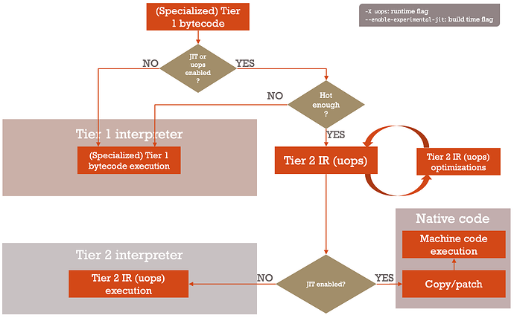

Slide 22
RANDOM STUFF
Typing
Platform support
Performance
Dropping old Python support

Slide 23
MORE TYPING
PEP 692, using TypedDict to annotate **kwargs
PEP 698, typing.override() decorator
PEP 696: Type parameters (typing.TypeVar, typing.ParamSpec, and typing.TypeVarTuple) now support defaults.
PEP 702: The new warnings.deprecated() decorator adds support for marking deprecations
PEP 705: typing.ReadOnly can be used to mark an item of a typing.TypedDict as read-only for type checkers.
PEP 742: typing.TypeIs provides more intuitive type narrowing behavior, as an alternative to typing.TypeGuard.

Slide 24
PLATFORMS
PEP 730: Apple’s iOS is now an officially supported platform, at tier 3.
PEP 738: Android is now an officially supported platform, at tier 3.
wasm32-wasi is now supported as a tier 2 platform.
> CPython support (wasm32-emscripten) and WASI (wasm32-wasi) targets. Emscripten builds run in modern browsers and JavaScript runtimes like Node.js. WASI builds use WASM runtimes such as wasmtime.

Slide 25
PERFORMANCE
asyncio has had perf. improvements, with benchmarks showing a 75% speed up
isinstance() checks against runtime-checkable protocols has changed significantly
Using the BOLT binary optimizer in the build process improves performance by 1-5%.
Several standard library modules have had their import times significantly improved.

Slide 26
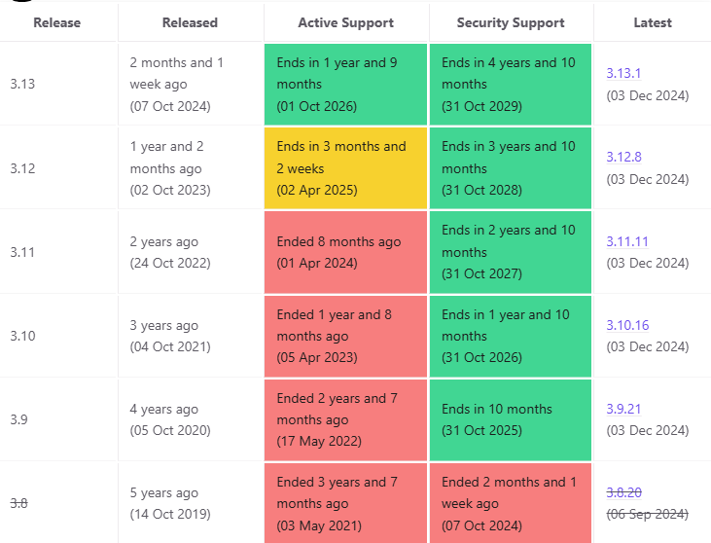
TIME TO DROP SUPPORT FOR <3.9
Python 3.8 is now completely EOL:
https://endoflife.date/python
Numpy: Python 3.10+
Django: Python 3.10+
Pytorch: Python 3.8+ (for now)

Slide 27
WHAT ELSE?

Slide 28
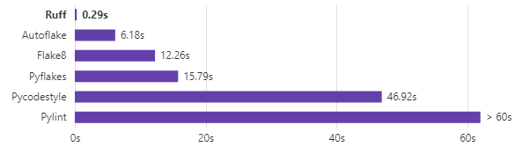
Ruff
An extremely fast Python linter and code formatter, written in Rust.
uv is backed by Astral.
Notes:
2min on cold cache, 18s on warm cache
1min on cold cache, 100ms on warm cache

Slide 29
From flake8 to ruff
[testenv:flake8]
deps =
flake8
flake8-2020
flake8-async
flake8-bugbear
flake8-warnings
flake8-debugger
flake8-broken-line
flake8-comprehensions
flake8-logging-format
flake8-printf-formatting
flake8-implicit-str-concat
flake8-datetime-utcnow-plugin
flake8-markdown
flake8-rst
flake8-pytest
yesqa
commands = flake8
[flake8]
exclude =
.*
*.egg-info
build
dist
.eggs
__pycache__
*_pb2.py
max-line-length = 100
ignore = E203,E402,W503,G200
//tox.ini
[testenv:ruff]
deps = ruff
commands = ruff .
// pyproject.toml
[tool.ruff]
line-length = 100
target-version = "py37"
extend-exclude = ['*_pb2.py']
select = [
"F", # pyflakes
"E", # pycodestyle
"W", # pycodestyle
"UP", # pyupgrade
"YTT", # flake8-2020
"B", # flake8-bugbear
"T10", # flake8-debugger
"C4", # flake8-comprehensions
"G", # flake8-logging-format
"ISC", # flake8-implicit-str-concat
"ICN", # flake8-import-conventions
]
ignore = [
"E402", # module-import-not-at-top-of-file
]
Notes:
2min on cold cache, 18s on warm cache
1min on cold cache, 100ms on warm cache

Slide 30
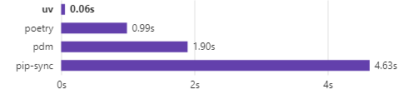
UV
An extremely fast Python package and project manager, written in Rust.
Notes:
2min on cold cache, 18s on warm cache
1min on cold cache, 100ms on warm cache

Slide 31
UV replaces pip
Just add “uv” before “pip” ☺
$ uv venv # create a venv $ uv pip install # no need to activate if the venv is named “.venv”
Virtualenvs are nothing magic: they just override $PATH and the sys.path This means you can use uv to create the venv but pip for other things.

Slide 32
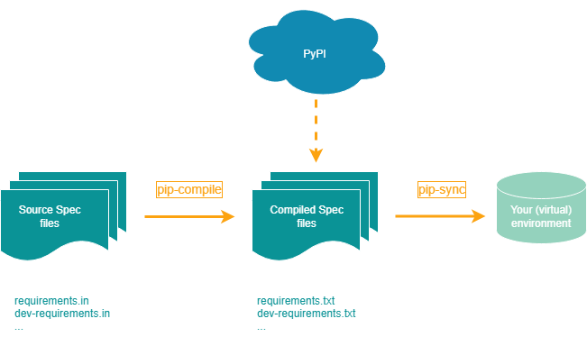
UV replaces pip-TOOLS
Pip-tools is useful to “lock” dependencies
$ uv pip compile requirements.in -o requirements.txt $ uv pip sync requirements.txt

Slide 33
UV replaces pipx
Pipx is great to install Python tools in separate venv:
$ uv tool install black $ uv tool install ruff $ uv tool install mypy

Slide 34
UV MANAGES PYTHON ITSELF
uv has no dependency on Python itself, as a single static binary.
It can download pre-built python distributions from python-build-standalone
$ uv python install 3.10 3.11 3.12 $ uv venv –python <some python I do not have on my system>

Slide 35
UV replaces everything else?
uv is also a complete workflow tool, like rye or poetry, it supports a universal lockfile:
$ uv init example Initialized project `example` at `/home/user/example`
$ cd example $ uv add ruff Creating virtual environment at: .venv Resolved 2 packages in 170ms Built example @ file:///home/user/example Prepared 2 packages in 627ms Installed 2 packages in 1ms + example==0.1.0 (from file:///home/user/example) + ruff==0.5.0
$ uv run ruff check All checks passed!

Slide 36
Use tox with uv
Just install the “tox-uv” plugin, and tox will automatically use uv.
Pro-tip: read this to make tox run faster https://hynek.me/articles/turbo-charge-tox/
Notes:
The first line tells tox to build and install wheels instead of source distributions, and the second line tells it to share the same build environment – and thus wheel – across all tox environments.

Slide 37
WHAT is coming?

Slide 38
What can we expect in the future?
Python 3.14 is currently under development:
PEP 649 – Deferred Evaluation Of Annotations
Improve free-threaded builds
Improved performance
JIT work on-going
Python API to manipulate subinterpreters (likely as an external Python package)
uv is likely becoming the “cargo of Python”

Slide 39
Come at my next concurrency talk ☺
Model | Execution | Start-up time | Data Exchange | Style
coroutine | Concurrent | smallest | Any | Cooperative
threads | Parallel * | small | Any | Preemptive
multiprocessing | Parallel | large | Serialization or Shared Memory | Preemptive
subinterpreters | Parallel | medium | Serialization or Shared Memory | Preemptive
(*) On regular Python builds, multi-threading is not really parallel because of the GIL

